Slide 1
CS460 - Senior Design
Team 5 – VR Application Research & Development
T. Avery Eich
Asad Ashur
Daniel Johnson

Slide 2
Midterm Status Report
Research Data Collection
Data Application Development
Dev. Tool and Hardware Setup

Slide 3
Research Data Collection
Asad Ashur

Slide 4
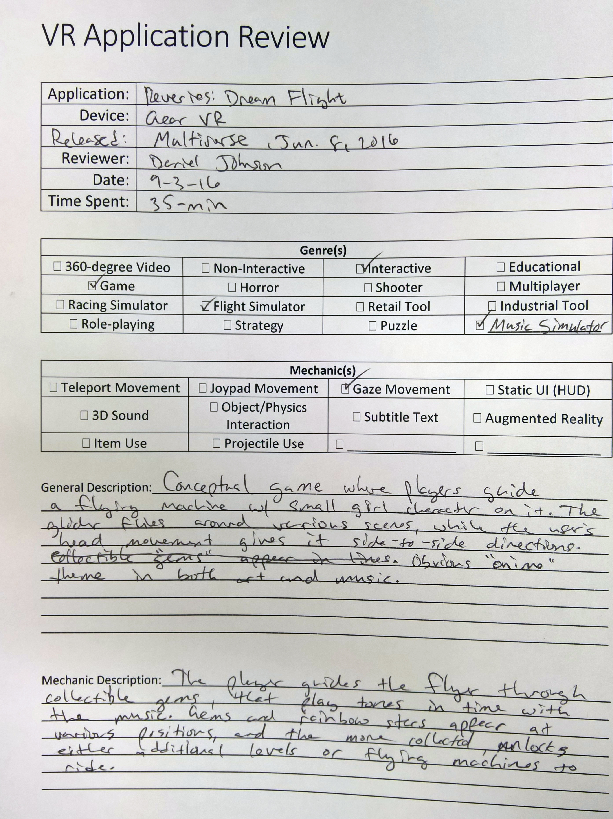
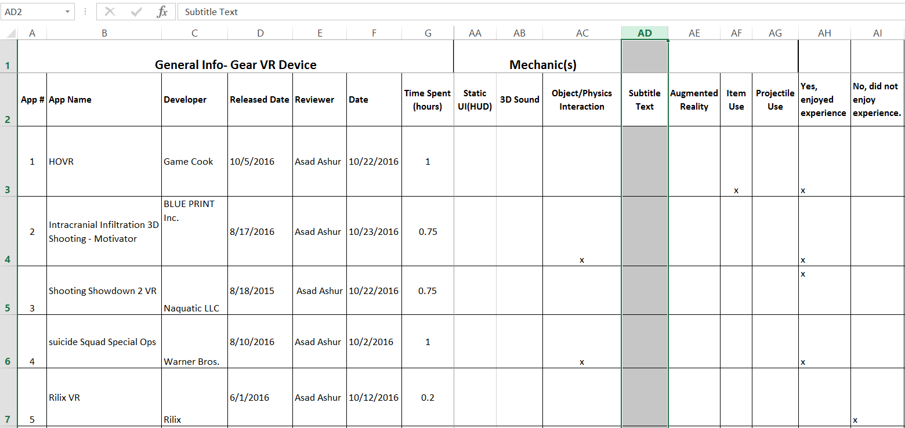
Research Data Collection
Manual Entry of Data (paper/excel)
Collected from application “review” process.
Included application metadata and subjective review.

Slide 5
Genres
Research Data Collection (cont.)
Visibility of data via graph format
Mechanics

Slide 6
Sample Evaluation
App Name | Pros | Cons | Rating
HOVR | Objects & obstacles Jump and slide on rails Ride skateboard | Nitro does not fly Does not have many controls Does not move in all directions | 4.5
Intracranial Infiltration 3D Shooting - Motivator | Simple and easy to play Being able to upgrade the ship with money There are levels Ion beam attack | Limited direction movement Two items only Few # of enemies | 4
Overall Rating

Slide 7
Data Application Development
Daniel Johnson

Slide 8

Research Data Storage
Desired additional visibility of data, including analysis and relation.
Developed Entity-Relationship Diagram based on the application characteristics.

Slide 9

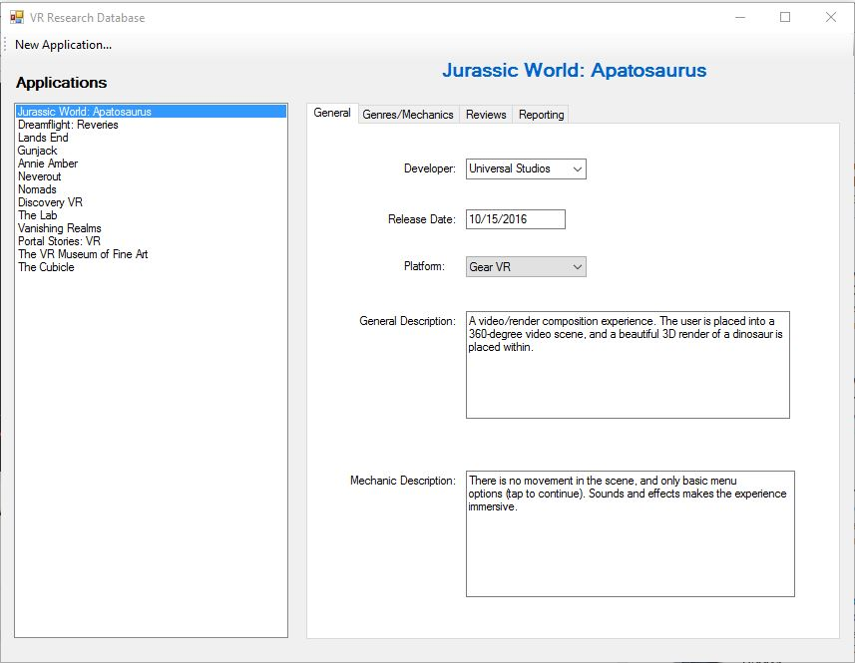
Data Entry and Collection
Data-driven desktop application developed to facilitate data entry and organization.
Microsoft Windows Forms
GitHub

Slide 10
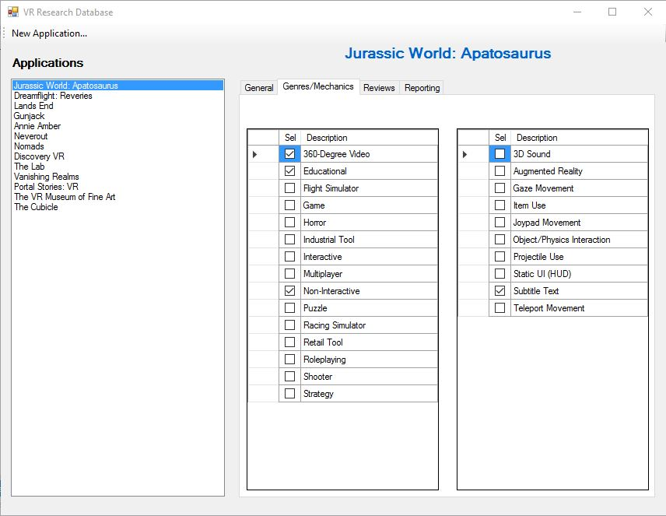
Data Lookup and Display
Find specific attributes for reference during development.
Keep track of review metrics for reporting.

Slide 11
Development Tools & Hardware Setup
T. Avery Eich

Slide 12
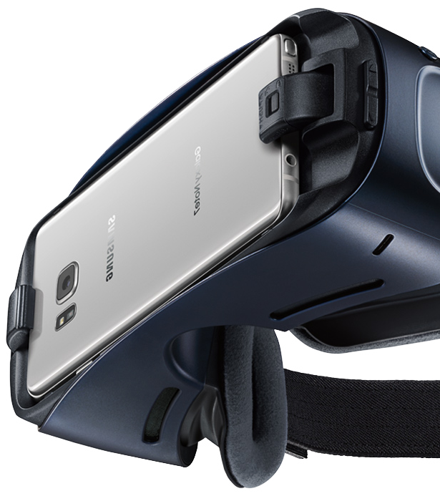
Gear VR Development
Oculus and Android SDK Packages
Easy to install deploy
Same as Android application development cycle
Plenty of documentation and support for Android
Why Gear VR?
Mobile
Accessible (price)
Unity Integration support.

Slide 13

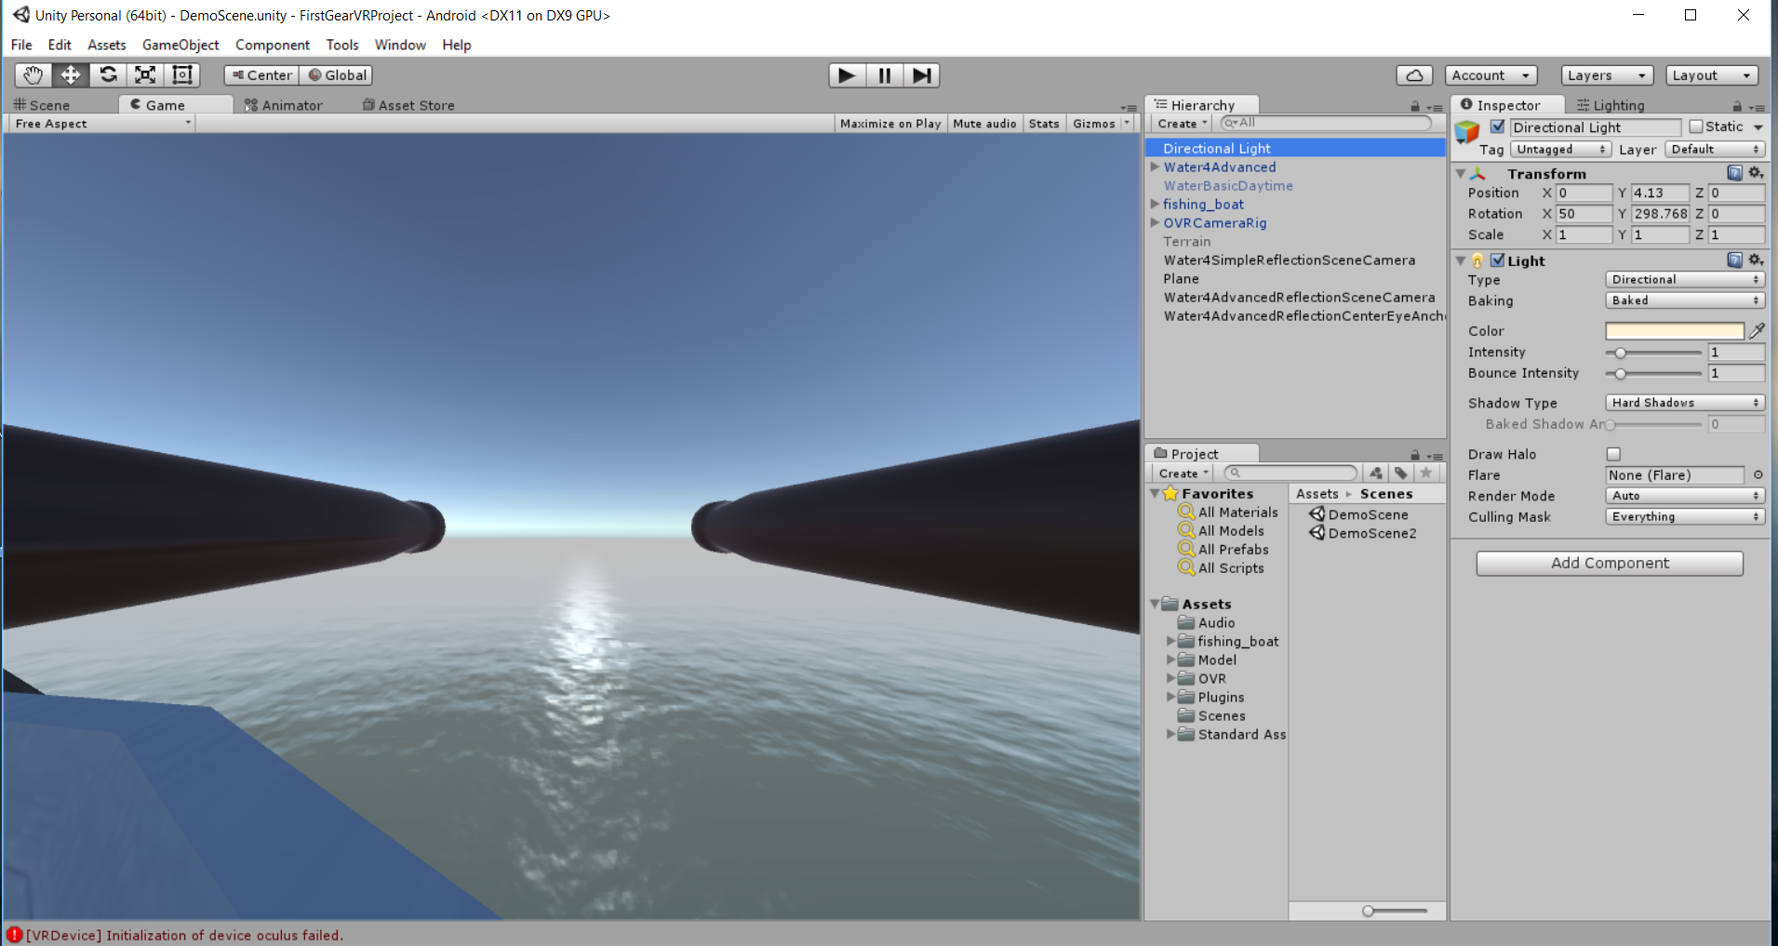
Unity Development
Unity 5 Integration Package from Unity3D.com
Imported package to Unity
Reviewed example projects
Developed custom project
Deployed application to Gear VR
Gained experience with deployment pipeline (testing).

Slide 14
Conclusion
Current Tasks
Research Oclulus Rift project deployment.
Research integration of AR plugin (Vuforia) to gain motion tracking with Gear VR.
Fully develop application implementation plan to be executed second semester.
Use research data and analysis to drive the application vision.

